Slide 1
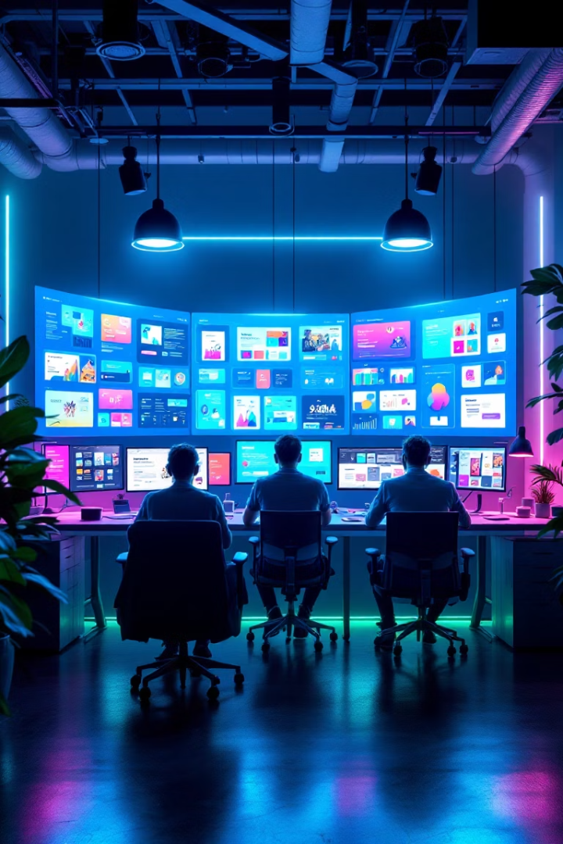
Infinite Pixel Studio
Welcome to our 2025 project presentation showcasing the design and development of a one-page website for Infinite Pixel Studio, a creative web development agency focused on delivering exceptional digital experiences.
This presentation outlines our approach to creating a website that effectively communicates the agency's capabilities, showcases their portfolio, and attracts potential clients through a clean, modern design that embodies their technical expertise and creative vision.

Slide 2
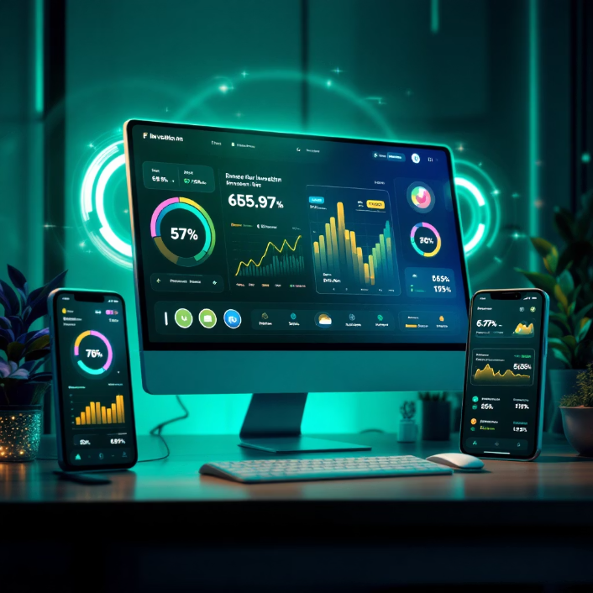
Project Overview
The Infinite Pixel Studio website is a comprehensive one-page digital solution, meticulously crafted to showcase the agency's diverse capabilities and attract potential clients. Our team focused on integrating modern design principles and adhering to the latest industry best practices for a visually appealing and highly functional outcome.
Operating within a streamlined two-week development timeline, standard for custom one-page websites, our strategic focus was on achieving unparalleled mobile optimization and robust search engine discoverability. This ensured broad reach and effectiveness across various devices. The condensed, intuitive format allows visitors to effortlessly access all essential information without cumbersome navigation, promoting a seamless user experience.
This project underscores our expertise in delivering efficient yet impactful web solutions. By consolidating vital content into a single, cohesive page, we provide a clear, concise, and compelling narrative about Infinite Pixel Studio's unique value proposition, facilitating quick engagement and lead generation. The seamless integration of aesthetics and functionality truly embodies the studio's technical prowess and creative vision.

Slide 3





Main Goals
Showcase Core Services
Present web development, UI/UX design, and branding capabilities with clear explanations and visual examples that demonstrate the agency's expertise and approach.
Display Team Profiles
Highlight team members' skills, specializations, and personalities to create trust and show the human side behind the technical work.
Highlight Portfolio
Feature selected case studies with animated previews that demonstrate real-world applications of the agency's capabilities and creative solutions.
Provide Contact Options
Implement direct contact methods and emphasize the agency's unique identity and values to encourage client engagement.

Slide 4






Key Website Sections
Home
A compelling, visually rich introduction at the top of the page, featuring a clear value proposition and a strong call to action, designed to immediately engage visitors and convey Infinite Pixel Studio's creative vision.
About Us
Introduce Infinite Pixel Studio's mission, values, and story, building rapport with potential clients and communicating the agency's unique approach to web development and design.
Skills
Detailed descriptions of Infinite Pixel Studio's core offerings, including web development, UI/UX design, and branding capabilities. Each service will be visually explained with specific examples of the agency's expertise and methodological approach.
Projects
An interactive and engaging gallery featuring selected case studies with high-quality images and animated previews. This section will demonstrate real-world applications of the agency's solutions and illustrate their creative problem-solving capabilities.
Team
Dedicated profiles for each team member, showcasing their professional skills, specializations, and unique personalities. This section aims to build trust and highlight the human element behind the agency's technical and creative work.
Contact
A user-friendly contact form providing direct engagement methods. This includes not only the form itself but also key contact information, agency location, and links to relevant social media profiles, emphasizing Infinite Pixel Studio's unique identity and values to encourage client outreach.

Slide 5








Design Rules & Best Practices
SEO Optimization
User Experience Focus
Strategic use of keywords, meta titles/descriptions, and alt text to improve search visibility and drive organic traffic.
Intuitive navigation with jump-to-section menu and fast load times to enhance user satisfaction and engagement.
Consistent Branding
Accessibility
Unified logo, color scheme, and typography across all sections to reinforce brand identity and create a cohesive visual experience.
Proper color contrast, readable fonts, and mobile-first design to ensure the site is usable by all visitors regardless of device or ability.

Slide 6

Tools & Technologies Used
GitHub
VS Code
Version control for tracking changes
Primary code editor for development
Collaborative workflow for multiple developers
Extension ecosystem for enhanced productivity
Issue tracking and project management
Integrated debugging tools
Live server preview functionality
Deployment integration capabilities
WordPress Platform
Content management system foundation
Expandable architecture for future growth
Robust plugin ecosystem for extended features
User-friendly admin interface for client updates

Slide 7

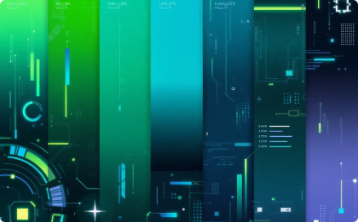
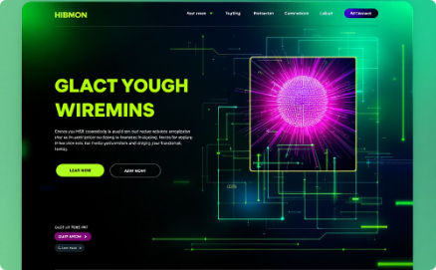
Creative Choices: Name, Colors, Layout
Meaningful Name
"Infinite Pixel Studio" was selected to convey the agency's commitment to limitless creativity and pixel-perfect precision in their work. The name suggests both technical expertise and boundless creative potential.
Tech-Inspired Colors
The color palette features blues and teals against dark backgrounds with strategic accent colors, creating a modern tech aesthetic that feels professional while still being visually engaging.
Clean, Modern Layout
The design employs minimalist principles with ample white space, subtle animated transitions, and a responsive grid system that ensures consistent experiences across all devices.

Slide 8










Team Roles & Learning Outcomes
Key Learnings
Importance of clear CTAs, benefits of modular design, value of user testing
Content Strategist
Copywriting, SEO optimization, content hierarchy
Developer
Coding, testing, deployment, performance optimization
UX/UI Designer
Wireframes, layout, user journey mapping, visual design
Project Manager
Timeline, scope management, client communication
Through this project, our team gained valuable insights into effective web design practices. We learned the critical importance of clear calls-to-action in driving user engagement, discovered how modular design facilitates easier updates, and witnessed firsthand the tremendous value of user testing in refining the overall experience.

